Slide 1
Angular Testing
6 - Testing Strategies
Notes:
Schwerer wirds nicht, dafür kann RxJS auch einiges
Komplexe RxJS kann aber nur mit Unit Tests testen
Man muss direkt an die Observables rankommen. Private Methoden oder so gehen nicht

Slide 2


Two Competing Schools of Unit Testing

Slide 3
Differences
London
Unit is a class
Mock everything except the class
Very tightly coupled to implementation
Disadvantages
No refactoring
Lots of code for mocking
No interplay testing
Advantages
Edge cases, finding bugs, exploratory
Great code quality (FP)
Fast
Detroit (Chicago)
Unit is a behaviour
Mock out-of-system dependencies
Runs against an API (UI)
Advantages
Great for refactoring
Efficient (coverage)
Disadvantages
Large setup required
Slow
Notes:
Cucumber hier erwähnen

Slide 4

London Style
Test Specs
Class

Slide 5
London Style
Test Specs
Mocking
Class

Slide 6
London Style
Test Specs
Mocking
Class

Slide 7
London Style
Test Specs
Mocking
Class

Slide 8
Detroit Style
Test Specs
Behaviour
Class

Slide 9
Detroit Style
Test Specs
Behaviour
Class
Out-of-System Dependency
e.g. HttpClient

Slide 10
Detroit Style
Test Specs
Behaviour
Class
Class
Mock
Out-of-System Dependency
e.g. HttpClient

Slide 11
Detroit Style
Test Specs
Behaviour
API
Module
Class
Class
Mock
Mock
Out-of-System Dependency
e.g. HttpClient
Notes:
Architecture counts here. If we don't come up with loosely coupled modules, the worst case is that all our angular elements (components, services) will be used.

Slide 12
Testing Pyramid Revisited
End-to-End Tests
Integration Tests
Unit Tests

Slide 13
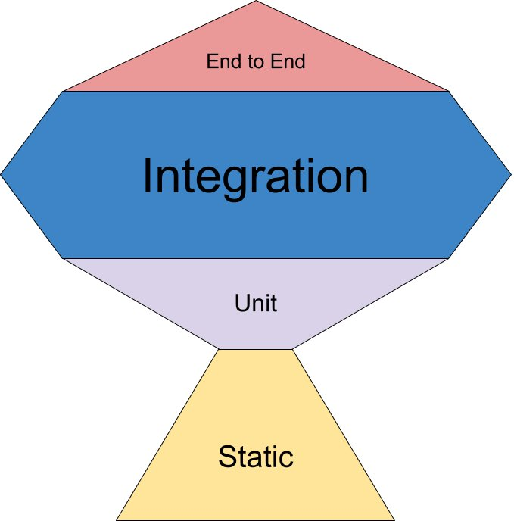
Testing According to ROI
Kent C. Dodds: https://twitter.com/kentcdodds/status/960723172591992832
Notes:
Largely Depends on Application
Most parts of data processing (unit test) done in backend
Frontend as "proxy" → less logic

Slide 14
HttpTest
it("should use Angular's http mock", () => { TestBed.configureTestingModule({ declarations: [RequestInfoComponent], imports: [ReactiveFormsModule, HttpClientTestingModule], });
const httpController = TestBed.inject(HttpTestingController); const fixture = TestBed.createComponent(RequestInfoComponent); fixture.componentInstance.search();
const request = httpController.match((req) => !!req.url.match(/nominatim/))[0]; request.flush([{ street: "Domgasse", streetNumber: 5 }]); expect(lookupResult.textContent.trim()).toBe("Address found"); });
Instead of HttpClientModule
Runs AFTER http request

Slide 15
RoutingTest
RouterTestingModule provides routing functionality for tests
Location can verify the expected url
RoutingConfiguration is required

Slide 16
Testable Architecture
Notes:
Es geht hier darum um eine Priorisierung vorzunehmen. In Anbetracht, dass nicht viel Zeit da ist. Große Abdeckung der Tests und nicht die Frage wie viel teste ich.

Slide 17
Different Testing Techniques
Unit / Integration Range
Full mocking, no TestBed
Selected mocking, without DOM interaction
Selected mocking, DOM interaction
Most minimal mocking, DOM Interaction
Exotic
RxJs Marbles
Visual Regression
Component Tests via Storybook/Cypress (E2E)

Slide 18
Potential Problems
Unit Tests (London)
What technique should be applied?
Too much mocking
Should I have unit test for everything?
Integration Tests (Detroit Unit)
Too much setup required → feels like E2E
What should I mock?

Slide 19
Unit vs. Integration
Largely Depends on Application
Most parts of data processing (unit test) done in backend
Frontend as "proxy" → less logic
Integration is King

Slide 20
Testable Architecture
Unit Tests
Class has a defined type
One testing technique per Type
Integration Tests
Reduction of dependencies via domain/feature boundaries
Integration Test per Domain/Feature
Entry point is the feature component

Slide 21
App Shell
Domain
Domain
Domain
Domain
Shared
Error Handling
Widgets
Backend Middleware
Forms
Grid
...

Slide 22
Component
Domain
Service
Module
Feature (Container Cmp.)
Data
UI (Presentational Cmp.)
Domain Models

Slide 23


Container & Presentational Components
Data
(ngrx)
Container
Components
Presentational
Components
selectors
@Input
actions
@Output
Minimal HTML/CSS
Lots of DI
Facilitator
HTML & CSS only
Minimal Typescript
No DI
@Input & @Output
No Observables
Notes:
Say that Presentational is not just about Generic UI Components.
It also makes sense if they form a pair or for UI components that have Domain Models as input

Slide 24
Sweet Spot
Integration Tests
Sweet Spot
Modules
Unit Tests
Edge Cases

Slide 25
Sweet Spot Examples
Per Domain
Per Feature
Tests which are too hard for E2E

Slide 26
Sweet Spot: Testing Techniques
Unit / Integration Range
Full mocking, no TestBed
Selected mocking, without DOM interaction
Selected mocking, DOM interaction
Most minimal mocking, DOM Interaction
Exotic
RxJs Marbles
Visual Regression
Component Tests via Storybook/Cypress (E2E)

Slide 27
Sweet Spot
Container
Components
State
Management
Presentational Components
Domain Models

Slide 28
Edge Cases
Integration Tests
Sweet Spot
Modules
Unit Tests
Edge Cases

Slide 29
Edge Cases Examples
Components
Services
Functions

Slide 30
Edge Cases: Testing Techniques
Unit / Integration Range
Full mocking, no TestBed
Selected mocking, without DOM interaction
Selected mocking, DOM interaction
Most minimal mocking, DOM Interaction
Exotic
RxJs Marbles
Visual Regression
Component Tests via Storybook/Cypress (E2E)

Slide 31
Edge Cases
Full Mocking / no TestBed
RxJs Marbles
Container
Components
State
Management
Presentational Components
Visual Regression
Snapshot
Domain Models

Slide 32
Modules
Integration Tests
Sweet Spot
Modules
Unit Tests
Edge Cases

Slide 33
Modules Examples
Interplay between Container & Presentational Components
Complex Components (DataGrid)
State Management
Tests with Browser support (LocalStorage,...)

Slide 34
Modules: Testing Techniques
Unit / Integration Range
Full mocking, no TestBed
Selected mocking, without DOM interaction
Selected mocking, DOM interaction
Most minimal mocking, DOM Interaction
Exotic
RxJs Marbles
Visual Regression
Component Tests via Storybook/Cypress (E2E)

Slide 35
Logical Groups
Selected Mocking with DOM interaction
Container
Components
Selected Mocking without DOM
State
Management
Presentational Components
Domain Models

Slide 36
Summary
Try to go for Integration Tests
Use Code Coverage as Analysis Tool
Leave the edge cases for Unit Tests with full mocking
Rest with "Modules" Tests
Apply the right Techniques:
Visual Regression: Presentational Components
RxJs Marbles: NgRx Effect
Storybook/Cypress: Component Groups

Slide 37

Lab
Lab Time
Notes:
Make aware that we haven't seen component or service so far in Action
Explain the usage of the data-test selectors
fakeAsync is quite common used here

